Slide 1
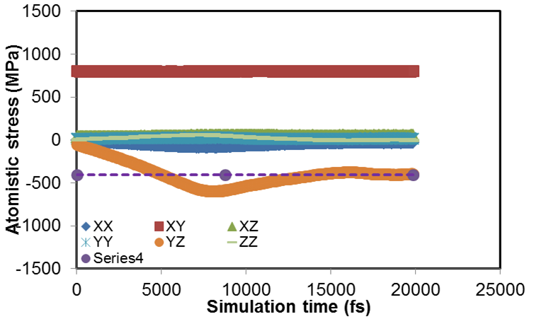
Comment: The purple dashed line is the ‘average’ value of τ_{yz}
Overdamped? Pdamp=10

Slide 2
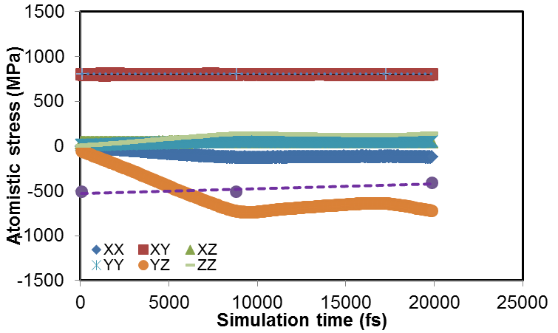
“underdamped” (or less overdamped) Pdamp=1000
Note – small,
But relatively
Negligible
Increase in
Normal stresses
Comment: The purple dashed line is the ‘average’ value of τ_{yz}

Slide 3
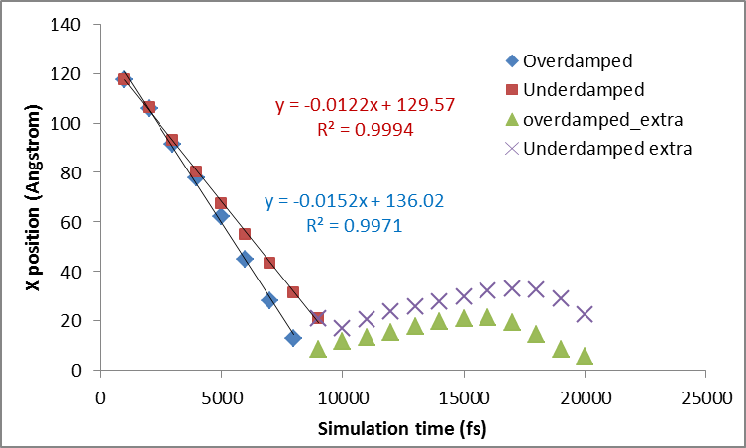

Slide 4
Yes, there is clearly non-steady value
of τ_{yz}, but this should ‘theoretically’ not
influence the dislocation velocity? Note that if the simulation is repeated
With slightly different values of τ_{xy} but
The same pdamp, the velocity is
Much more consistent!?!

